Slide 1
Capstone Project-3 Presentation on
Mobile Price Range Prediction
Presented By: Ankit Rai
Anis Bagwan

Slide 2

TABLE OF CONTENT
Defining Problem Statement
EDA and Feature Engineering
Feature Selection
Preparing Dataset for Modelling
Applying Model
Model Validation and Selection

Slide 3

PROBLEM STATEMENT
Today, phone market is considered as highly competitive, and one must do adequate research before entering or launching their new product. Cell phone market companies want to understand sales data of mobile phones and factors which drive the prices.
Our objective is to find out some relation between given features of a mobile phone(e.g.:- RAM, Internal Memory, etc.) and its selling price. Further , we will create a predictive model which could predict the range indicating how high the price is.

Slide 4
DATA PIPELINE
Data Processing : First we checked for null values, duplicate values and outliers in our data. Then we derived new variables from the existing variables and also dropped the variables which were not further required.
EDA : In this part we performed exploratory data analysis on the given data. We started with univariate analysis of our dependent feature and then performed multivariate analysis of binary and numeric independent variables.
Create a model : Finally after splitting our data and then rescaling training data values, we started creating classifier models. After training our data, we also evaluated our different models on the basis of their accuracy.
Hyperparameter tuning : After selecting our best model on the basis of their accuracy and CV score, we optimized our models tuning its hyperparameter.

Slide 5
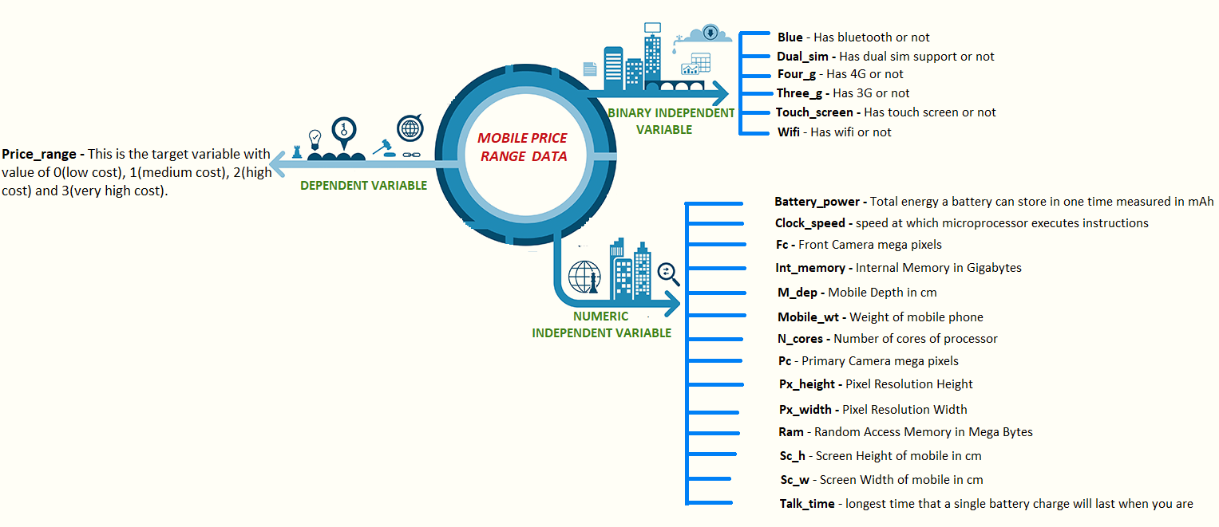
DATA SUMMARY

Slide 6
Data summary
Binary Independent Variable
Blue – Tells whether given phone Has Bluetooth or not
Dual_sim - Has dual sim support or not
Four_g – The feature shows that a particular mobile has 4G support or not.
Touch_screen – Tells whether given phone has touch screen feature or not
Wifi – Tells whether the given phone has Wifi or not
Three_g -The feature shows that a particular mobile has 3G support or not.

Slide 7
Data summary
Numeric Independent Variables
Battery_power - Total energy a battery can store in one time measured in mAh
Clock_speed - speed at which microprocessor executes instructions
RAM – It is the Random Access Memory measured in Mega Bytes.
Int_memory – This feature gives the Internal Memory of mobiles in Gigabytes.
Mobile_wt – This variable tells about the Weight of mobile phones.
Fc – Tells number of front camera megapixels
Pc – Tells megapixels of Primary Camera
N_cores – Shows the number of cores present in a given phone
M_dep - Mobile Depth in cm
Px_height - Pixel Resolution Height

Slide 8
Data summary
Numeric Independent Variables
Sc_h - Screen Height of mobile in cm
Sc_w - Screen Width of mobile in cm
Px_width - Pixel Resolution Width
Talk Time- longest time that a single battery charge will last
Dependent Variable
Price_range – This is our dependent/target variable , which tells about the price range to which the given phone belongs.

Slide 9
New Derived Features
sc_area (Screen Area)
This area tells about the screen size or it’s area to be precise. We have derived this new variable from two other variables :
sc_h (Screen Height)
sc_w(Screen Width)
sc_area = sc_h * sc_w
px_size (Pixel Size)
This new variables talks about display pixels size. We derived this new variable from other two variables :
px_height (Pixel Height)
px_width (Pixel Width
px_size = px_height * px_width

Slide 10
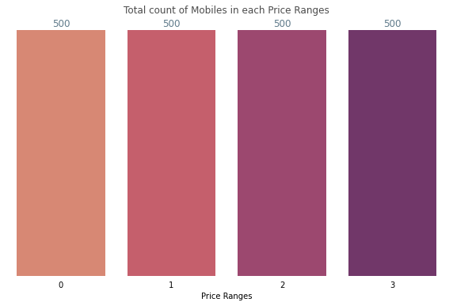
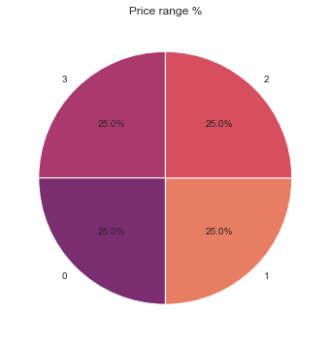
There are four types of price ranges :
0 : Low Cost range
1 : Medium Cost Range
2 : High Cost Range
3 : Very High Cost Range
All four classes are divided equally in our data.
Define Dependent
Variable

Slide 11
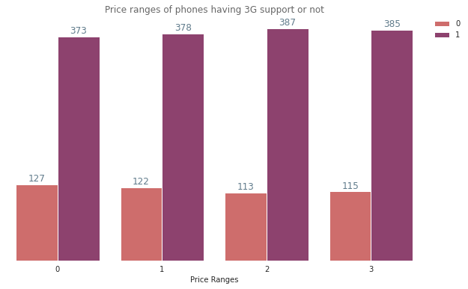
For every price range, most of the phones have 3g support.
That means in the market there are less number of mobiles which do not have 3G support.
Exploratory Data Analysis
Three-G Support of mobiles

Slide 12
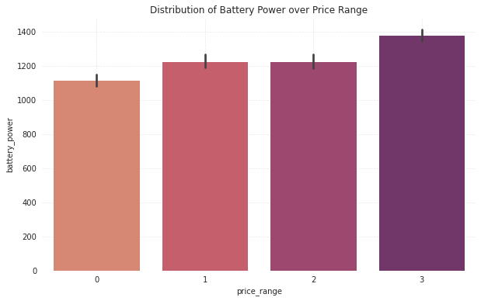
As the plot shows from 0 to 1 price range of mobiles increases as battery power increases.
The bars of price range 1 and 2 are equal that means the price range is constant.
From price range 2 to 3 again it starts to increase as there is increase in battery power.
From this we can say that the phones which have higher battery power can be classified into higher price range.
Exploratory Data Analysis
Battery power with price ranges of mobiles

Slide 13
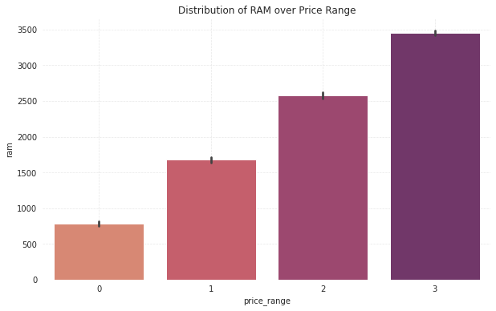
The mobile phones having high RAM are of high price range and the phones having low RAM are of low price range.
As RAM increases Price Range also increases and as RAM decreases Price Range also decreases.
From this we can say that in cell phone market RAM is game changing feature which decides the price range of mobiles.
Exploratory Data Analysis
RAM of Mobiles with each Price Range

Slide 14
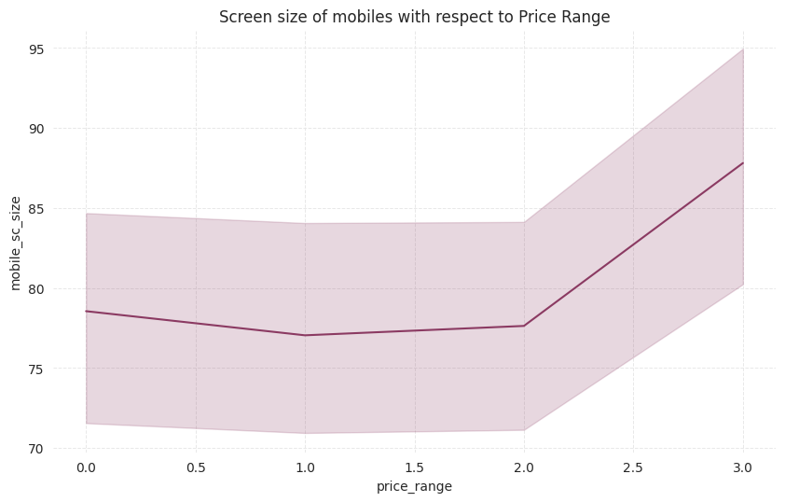
Low , medium and high cost phones have nearly same screen size.
Mobile phones with larger screen area have very high cost.
Exploratory Data Analysis
Screen Size of mobiles with respect to Price Range

Slide 15
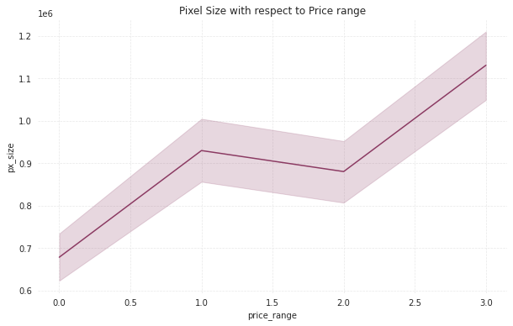
For low price range phones pixel size does matter that means higher pixel size gives more price range.
For medium price range it is not like that, for some medium price ranges pixel size does not matter that means some of medium range phones the pixel size is low compared to low price range.
But in expensive price range the pixel is also high with respect to price range.
Exploratory Data Analysis
PIXEL SIZE OVER DIFFERENT PRICE RANGE

Slide 16
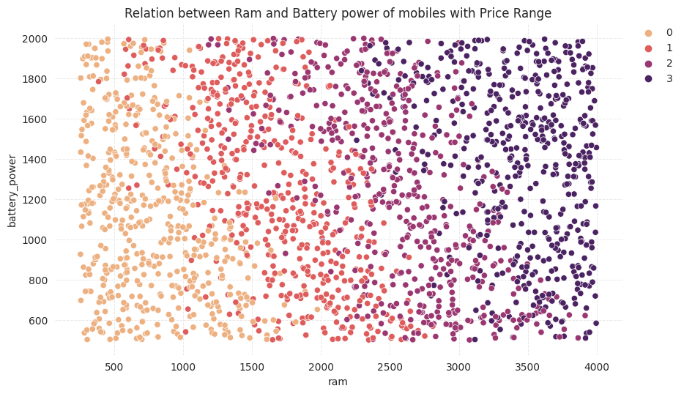
The scatter plot shows the relation of ram and battery power with respect to price range of mobiles.
As we can see when the ram and battery power are less at that time price of that particular mobile is also low.
And when battery power and ram are high the price range is also high.
Exploratory Data Analysis
RAM and Battery Power of mobiles

Slide 17
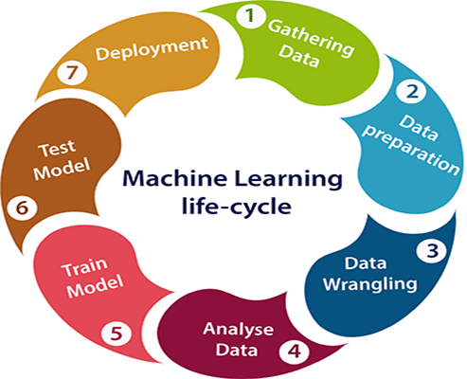
Data Preparation for Modelling
Splitting data for Training and Testing :
First we assigned our dependent and independent variable values to new variables X and y respectively.
We split 20% data for testing and rest for training.
Train Set: (1600,21)
Test Set: (400,21)

Slide 18
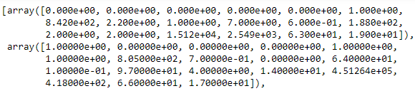
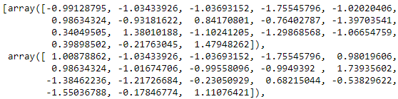
Data Preparation for Modelling
Rescaling Numeric Values– Standardization
Before applying models, it is important to generalize our data. For this we will be using standardization method. Standardization gives all features the same influence on the distance metric. If one feature has very large values, it will dominate over other features when calculating the distance.
Before Standardization ‘X_test’
After Standardization ‘X_test’

Slide 19

Applying Model
Since our dependent variable is a multiclass variable, we preferred to go and try following models :
Naive Bayes Classifier
Decision Tree Algorithm
Random Forest Classifier
KNN Algorithm

Slide 20
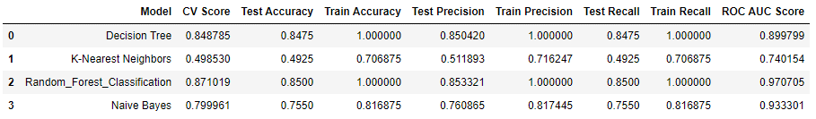
Model Validation and Selection
Observation : Decision Tree and Random Forest are giving best results. However, Random Forest has given slightly better results in ROC AUC score.

Slide 21
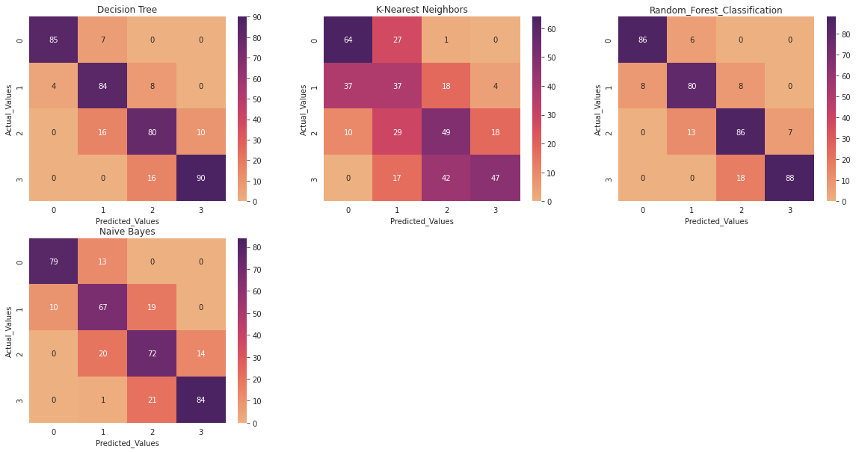
Confusion Matrix

Slide 22
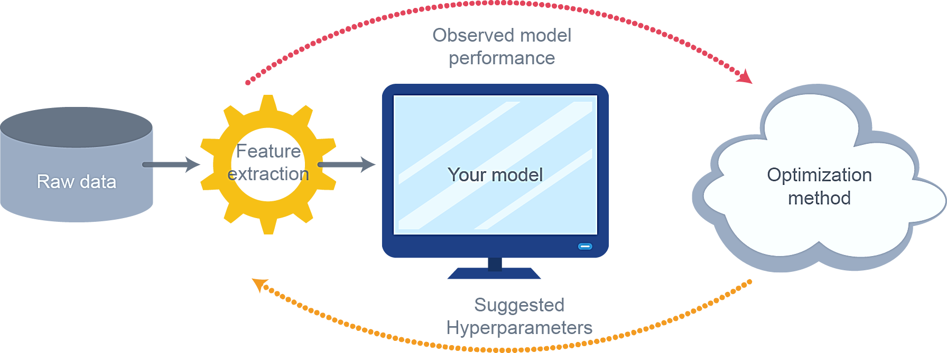
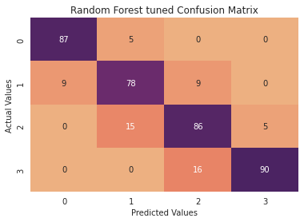
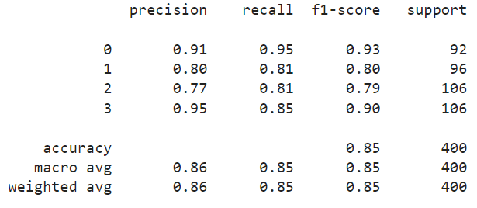
We had chosen Random Forest Classifier for our prediction and the best Hyperparameters obtained are as below.
criterion = ‘entropy’
max_depth = 8
max_features = ‘log2’
N_estimators = 200
Hyperparameter Tuning

Slide 23
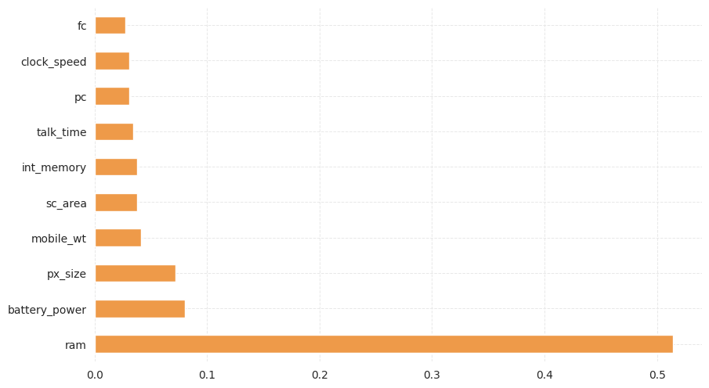
Feature Importance
The feature importance (variable importance) describes which features are relevant.
It can help with better understanding of the solved problem and sometimes lead to model improvements by employing the feature selection.

Slide 24
Conclusion
We started this project with the intention to identify the useful variables/factors which drives phone price and to build a predictive model which can give phone price range depending on its feature.
For this, we performed exploratory data analysis on our data after cleaning and making it easy to analyze. This analysis helped us to identify variables which directly impacts Mobile Phone Prices.
We found that 'RAM' of a phone linearly affects the phone prices. Other variables like battery life and px_size also shows linearity (up to extent only) with the phone prices.
We found that most very high-cost phones have low handset weight, high Internal Memory, high pixel and screen size.
Our next job was to make a price range predictive model. For this, we processed our data, split it for training and testing and finally applied four different models.
Both Random Forest and Decision tree classifiers gave some good accuracy scores, however on cross validation scores Random Forest performed much better.
This gave us confidence to perform hyperparameter tuning on our Random Forest model.
Finally, we optimized our model, which increased the accuracy score of our model to 0.86,which is pretty decent.

Slide 25
THANK YOU

